Slide 1
Android Based Sleep Apnea Monitor
Guided by
Mr. Jagadeesh Kumar P
Presented by
Ajmal M Ali
Reg No: 98914067
M. Tech VLSI and ES

Slide 2
CONTENTS
Introduction
Existing System
Objective
Literature Review
Block Diagram
Work Done
Results
Conclusion
References

Slide 3
INTRODUCTION^{[3]}
Sleep Apnea is the abnormal pauses in breathing during sleep.
2 classes
  Central Sleep Apnea(CSA).
  Obstructive Sleep Apnea(OSA)
Symptoms - snoring, pauses in breathing during sleep, choking or gasping for air following breathing , daytime sleepiness , headaches, dryness of throat , lack of concentration ability, urination at night, depression and irritability, and obesity

Slide 4
EXISTING SYSTEM
EXISTING SYSTEM^{[4]}
  Polysomnography(PSG)
Thorough and reliable test.
100 % Accuracy.
Full night sleep under doctors and nurses supervision.
Breath air flow, respiratory movement, oxygen saturation, EEG, EMG, EOG, and ECG, as well as body position.

Slide 5
DRAWBACKS
Also has its problems
  Have to stay in hospital for one night.
  Have to be hooked up to a no: of electrodes.
  A Doctor has to stay with the patient through out the night.
  Uncomfortable.
  It is an expensive process.
  Many sleep centers worldwide are currently operating at full capacity.

Slide 6
OBJECTIVE
Android Based Sleep Apnea Detection.
  Detection of QRS complex from ECG signal
  Detection of R-R interval from the ECG signal
  Calculation Of Heart Rate.
  Extraction of Features.
  Detection of Sleep Apnea Episodes.
  Classification based on severity.

Slide 7
LITERATURE REVIEW
PSG as a golden standard.
ECG and Photoplethysmography signal for detecting Sleep Apnea.
However, PPG does not provide any details about the severity of Sleep Apnea.
EDR and RR-interval.
Cyclic variation of heart rate (CVHR).

Slide 8
QRS COMPLEX DETECTION^{[5][14]}
Different QRS detection algorithms include:
1. Template Matching Techniques
2. Differentiation Based Method
3. Pan Tompkins Algorithm

Slide 9
FEATURE EXTRACTED^{[3]}
RR-interval.
Heart Rate.
Epoch Length.
The NN50 measure (variant 1), defined as the number of pairs of adjacent RR intervals where the first RR interval exceeds the second RR interval by more than 50 ms.
The NN50 measure (variant 2), defined as the number of pairs of adjacent RR intervals where the second RR interval exceeds the first RR interval by more than 50 ms.

Slide 10
APNEA-HYPOPNEA INDEX^{[3]}
Index used to indicate the severity of sleep apnea.
It is represented by the number of apnea and Hypopnea events per hour of sleep.
The AHI is calculated by dividing the number of apnea events by the number of hours of sleep.
AHI values are categorized as:
  Normal: 0-4
  Mild Sleep Apnea: 5-14
  Moderate Sleep Apnea: 15-29
  Severe Sleep Apnea: 30 or more

Slide 11
BLOCK DIAGRAM^{[4]}
ECG Signal
Preprocessing
QRS Detection
RR Interval Estimation
Apnea Detection
Feature Extraction

Slide 12
ECG SIGNAL
The Physionet data base is used as the input to the system.
The data consist of 70 records, divided into a learning set of 35 records and a test set of 35 records, all of which may be downloaded.
Recordings vary in length from slightly less than 7 hours to nearly 10 hours each.

Slide 13
PAN TOMPKINS ALGORITHM^{[5]}
ECG Signal
Band Pass Filter
Differentiator
Squaring
Thresholding
Moving Average Filter

Slide 14

LOW PASS FILTER^{[5]}
Reduce Power-line noise because it suppress the high frequency noise.
Mainly due to difference in electrode impedances and stray currents through patient and cables.
Power line noise in the range of 60 Hz.
Second Order Low Pass Filter
Cut Off 15 Hz.

Slide 15

HIGH PASS FILTER^{[5]}
Reduce Baseline Wander.
Noise include Breathing Noise, Loose sensor contacts, Body Movements, Perspiration etc.
Lies in the range of 0.5 Hz.
A High Pass Filter of Cutoff 5 Hz is used.

Slide 16

DERIVATIVE^{[5]}
The Differentiation is standard technique for finding the high slopes that normally distinguish the QRS complex from other ECG peaks.

Slide 17
SQUARING^{[5]}
That is all signal samples are squared point-by-point.
This operation makes all data points in the processed signal positive, and it amplifies the output of the derivative process nonlinearly.
It emphasizes the higher frequencies in the ECG signal, which are mainly due to the QRS complex and restricts false positive caused by T waves.

Slide 18
MOVING AVERAGE FILTER^{[5]}
The slope of R wave alone is not a guaranteed way to detect a QRS event.
Many abnormal QRS complexes that have large amplitudes and long durations might not be detected using information about of slope of R wave only.
Thus for detecting QRS event more information has to be extracted.

Slide 19
THRESHOLDING^{[5]}
In this the output of the moving window integrator need to be compared with a certain threshold value.
QRS complexes are detected in regions where the filtered signal rises above the threshold.
A lower threshold is used if no QRS is detected in a certain time interval.

Slide 20
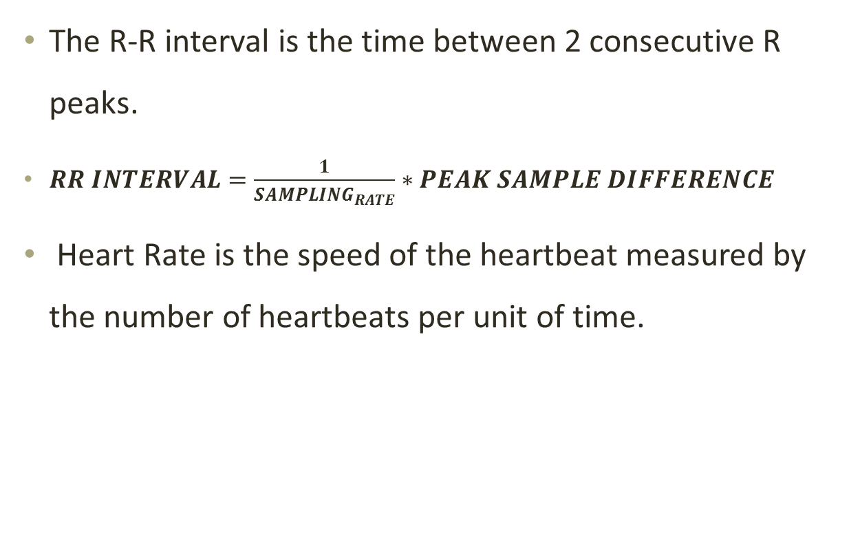

R-R INTERVAL & HEART RATE

Slide 21
REQUIREMENT ANALYSIS
GNU Octave
Android SDK
  Eclipse and ADT plugin.
  Android SDK Tools
  The latest Android platform.
  The latest Android system image for the emulator

Slide 22
WORK DONE
The sleep Apnea ECG data was obtained from Physionet Sleep Apnea ECG database.
The database was up-sampled/down-sampled to a sampling frequency of 200 samples per second.
The Pan Tompkins algorithm was applied on the database and the following were detected:
  QRS Peak
  R-R interval
  Heart Rate
The different Features were extracted.
Apnea was classified.

Slide 23
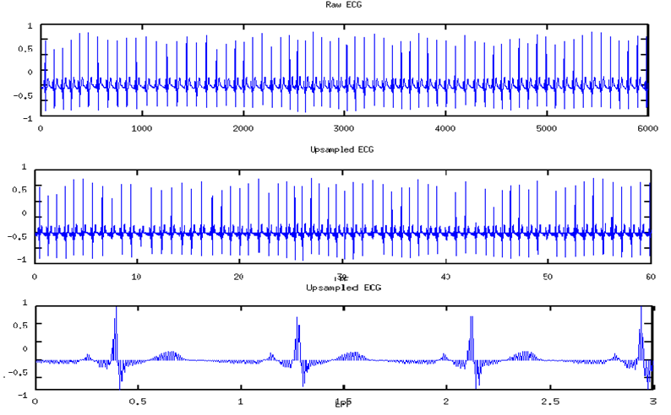
ECG Signal

Slide 24
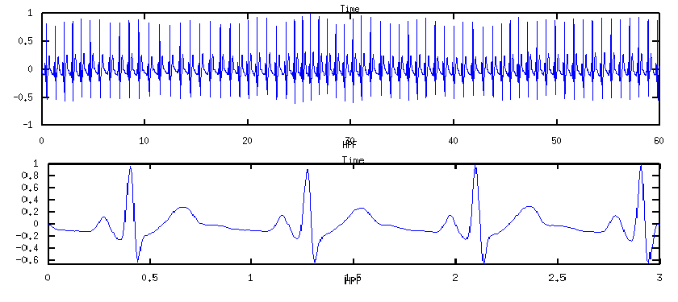
LOW PASS FILTER

Slide 25
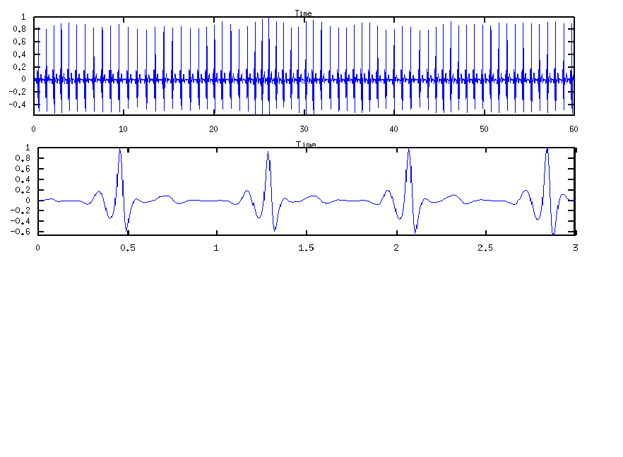
HIGH PASS FILTER

Slide 26
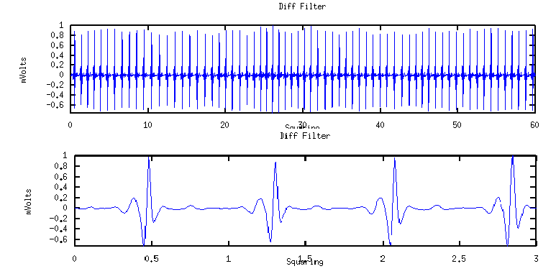
DERIVATIVE

Slide 27
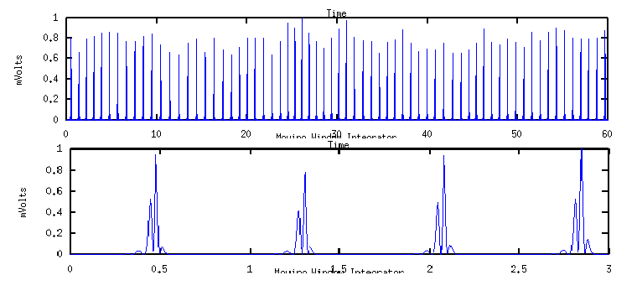
SQUARING

Slide 28
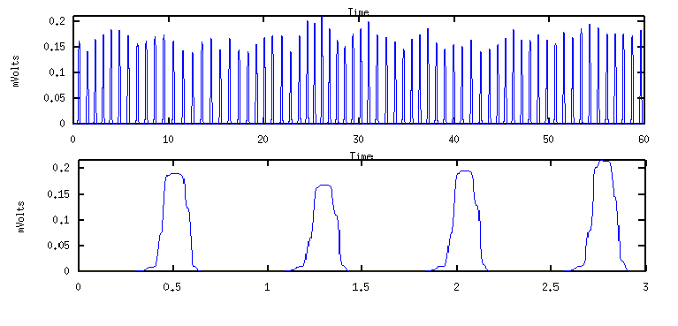
MOVING AVERAGE FILTER

Slide 29
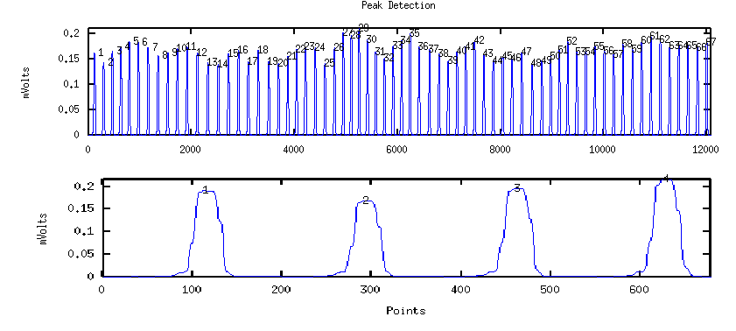
THRESHOLD

Slide 30
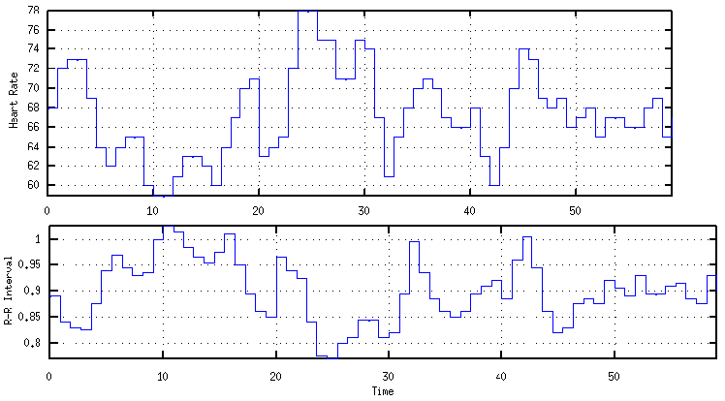
R-R INTERVAL & HEART RATE

Slide 31
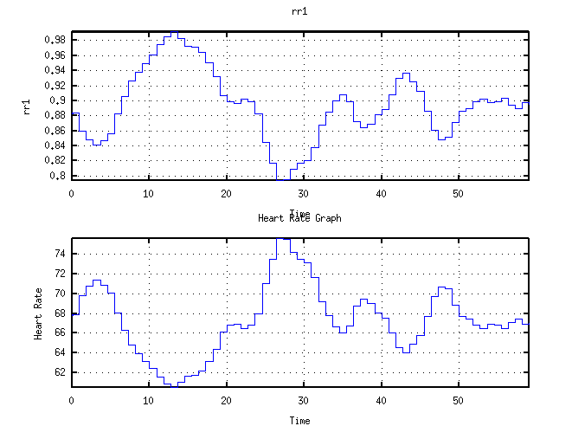
AVERAGED RR INTERVAL AND HR

Slide 32
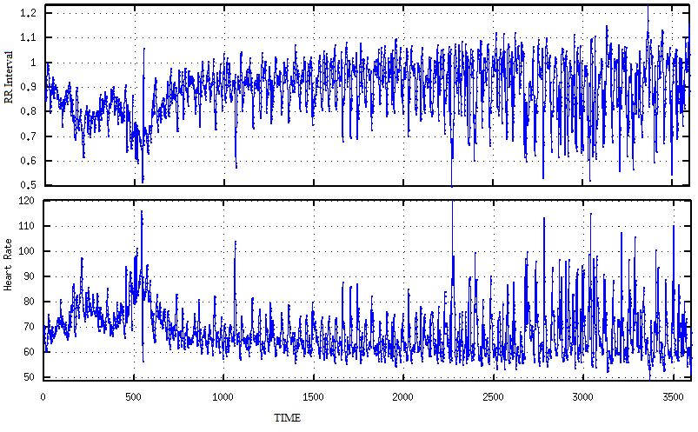
RR INTERVAL AND HR

Slide 33

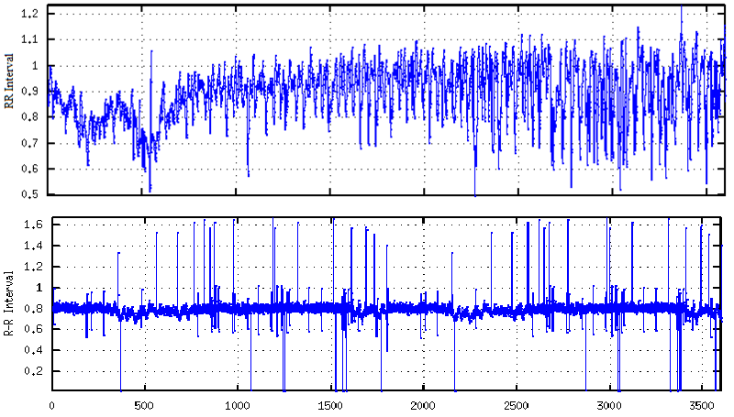
R-R INTERVAL

Slide 34
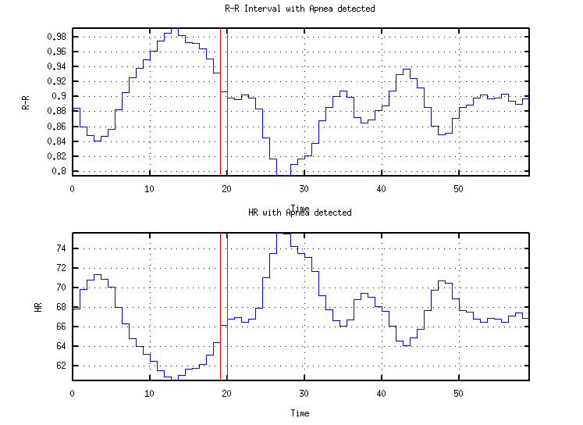
APNEA EPISODE DETECTION

Slide 35
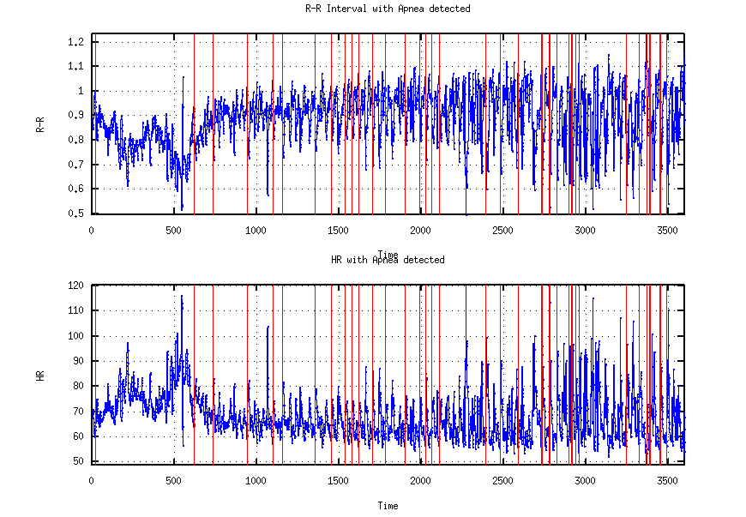
APNEA EPISODE DETECTION

Slide 36

APNEA HYPOPNEA INDEX

Slide 37
RESULTS
Epoch | R-R Diff. | NN50 | Apnea | Detected | Accuracy
5 sec | 50 ms | 4 No’s | 4493 | 2503 | 55.71 %
5 sec | 55 ms | 4 No’s | 4493 | 2564 | 57.07 %
5 sec | 60 ms | 4 No’s | 4493 | 2741 | 61.01 %
6 sec | 50 ms | 4 No’s | 4493 | 2516 | 56.00 %
6 sec | 55 ms | 5 No’s | 4493 | 2806 | 62.45 %
6 sec | 60 ms | 6 No’s | 4493 | 2887 | 64.25 %
7 sec | 50 ms | 4 No’s | 4493 | 2741 | 61.01 %
7 sec | 55 ms | 5 No’s | 4493 | 3016 | 67.12 %
7 sec | 60 ms | 6 No’s | 4493 | 3170 | 70.56 %
8 sec | 50 ms | 5 No’s | 4493 | 3120 | 69.44 %
8 sec | 55 ms | 5 No’s | 4493 | 3192 | 71.05 %
8 sec | 60 ms | 5 No’s | 4493 | 3251 | 72.35

Slide 38
RESULTS
Epoch | R-R Diff. | NN50 | Apnea | Detected | Accuracy
8 sec | 60 ms | 6 No’s | 4493 | 3367 | 74.93 %
9 sec | 60 ms | 5 No’s | 4493 | 3195 | 71.11 %
9 sec | 60 ms | 6 No’s | 4493 | 3277 | 72.94 %
10 sec | 60 ms | 6 No’s | 4493 | 3152 | 70.16 %

Slide 39
CONCLUSION
The existing system has many criticism.
ECG signal was used for the detection of Sleep Apnea.
This would make the diagnosis much more easier, cost effective, easily available.
The max accuracy was obtained as 74.93%.
The max accuracy was obtained at epoch length=8sec, R-R difference = 60ms and the variant length(I & II) = 6.

Slide 40
FUTURE WORK
Write the code in Java.
Implement in Android.
Add more features to improve accuracy.
Heart Rate Turbulence.

Slide 41
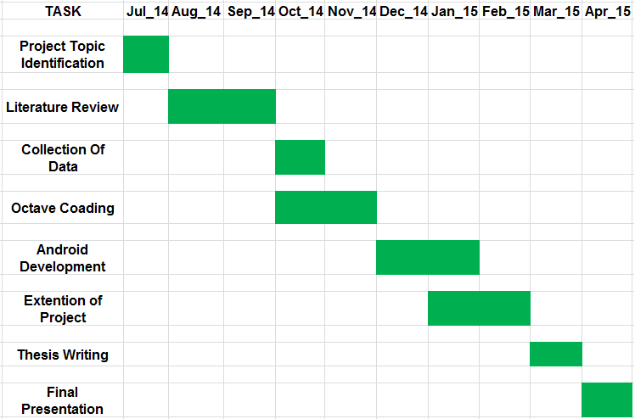
PROJECT SCHEDULE

Slide 42
REFERENCES
[1] Lili Chen, Xi Zhang, and Changyue Song, "An Automatic Screening Approach for Obstructive Sleep Apnea Diagnosis Based on Single Lead Electrocardiogram", IEEE TRANSACTIONS ON AUTOMATION SCIENCE AND ENGINEERING, VOL. 12, NO. 1, 2014.
[2] Nemanja Filipovi, Radovan Stojanovi and Anetta aplnov, "Real-Time Processing and Analysis of Cardiac Signals Using Android Smartphones," 3rd Mediterranean Conference on Embedded computing, 2014.
[3] Laiali Almazaydeh, Khaled Elleithy, Miad Faezipour, "Obstructive Sleep Apnea Detection Using SVM-Based Classication of ECG Signal Features", 34th Annual International Conference of the IEEE EMBS,2012.
[4] Laiali Almazaydeh, Khaled Elleithy, Miad Faezipour, "Detection of Obstructive Sleep Apnea Through ECG Signal Features", 2012.
[5] JIAPU PAN AND WILLIS J. TOMPKINS,,"A Real-Time QRS Detection Algorithm", IEEE TRANSACTIONS ON BIOMEDICAL ENGINEERING, VOL. BME-32, NO. 3, MARCH 1985.

Slide 43
[6] Nemanja Filipovi, Radovan Stojanovi, Nedjeljko Leki and Anetta aplnov, "Monitoring and Analysis of Vital Physiological Parameters Using PDA Devices", IEEE Trans Biomed Eng., 2014.
[7] Eka Adi Prasetyo Joko Prawiro, Chia-Chun Hu, Yi-Sheng Chan, ChengHung Chang, and Yuan-Hsiang Lin, "A Heart Rate Detection Method for Low Power Exercise Intensity Monitoring Device", IEEE International Symposium on Bioelectronics and Bioinformatics (IEEE ISBB 2014) , 2014.
[8] Vernica Peiteado-Brea, Diego Alvarez-Estevez IEEE Member, Vicente Moret-Bonillo, "A Study of Heart Rate Variability as Sleep Apnea Predictor over Two Deferent Databases", 2014.
[9] Junichiro Hayano, Eiichi Watanabe, Yuji Saito, Fumihiko Sasaki, Keisaku Fujimoto, Tetsuo Nomiyama, Kiyohiro Kawai, Itsuo Kodama and Hiroki Sakakibara, “Screening for Obstructive Sleep Apnea by Cyclic Variation of Heart Rate”,Circ Arrhythm Electrophysiol. 2010.

Slide 44
[10] AH Khandoker, CK Karmakar, M Palaniswami, "Screening Obstructive Sleep Apnoea Syndrome from Electrocardiogram Recordings Using Support Vector Machines",2007.
[11] T Penzel, GB Moody, RG Mark, AL Goldberges, JH Peter,"The Apnea ECG Database".
[12] Leif Sornmo , Pablo Laguna, "Electrocardiogram Signal Processing", Wiley Encyclopedia of Biomedical Engineering,Published Online, 2006.
[13] K. Dingli, T. Assimakopoulos, P.K.Wraith, I. Fietze, C. Witt, N.J. Douglas, "Spectral oscillations of RR intervals in sleep apnoea/ hypopnoea syndrome patients", European Respiratory Journal, 2003.
[14] Christos Pavlatos, Alexandros Dimopoulos, G. Manis and G. Papakonstantinou, "Hardware implementation of pan & tompkins qrs detection algorithm", 2003.

Slide 45
THANK YOU!!!

